Slide 1

Capstone Project:
Traffic Congestion Prediction
Presented by: IRAKOZE Grace Vanny,
Student ID: 26425
Course: Introduction to Big Data
Project Name: Traffic Congestion Predictions.

Slide 2
Introduction
The Challenge of Urban Traffic Jams.
Traffic congestion: refers to a pervasive issue in urban areas, leading to significant delays, increased fuel consumption, and environmental pollution.
This project aims to leverage big data analytics to predict traffic congestion, providing valuable insights for urban planning and real-time traffic management.

Slide 3
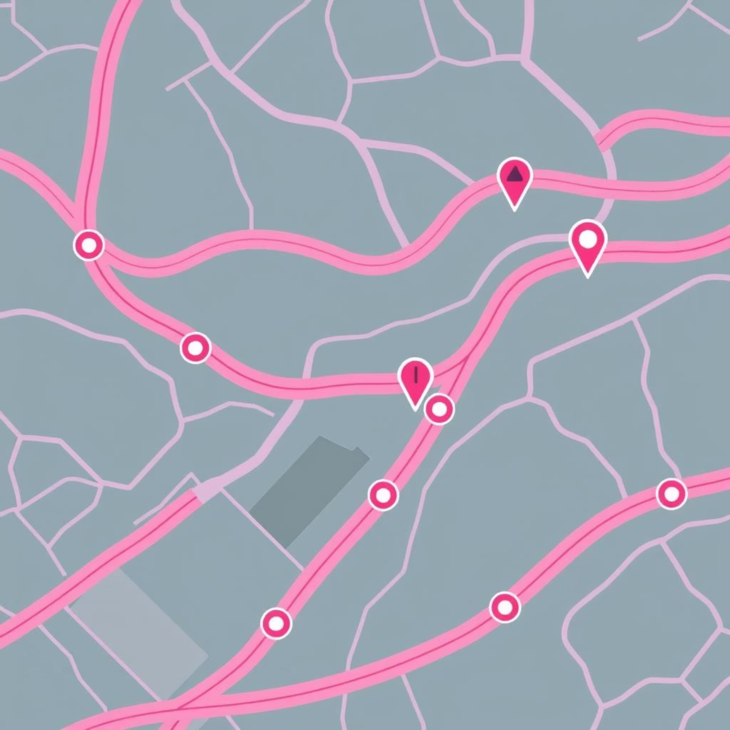
Problem Statement:
Predicting Peak Congestion
Can we accurately predict instances of severe traffic congestion in urban transportation networks using historical traffic data, environmental factors, and event-based information?
This project focuses specifically on the Transportation network within our countries like here in Rwanda.

Slide 4

Dataset Identification and Acquisition
Key Data Sources:
Traffic Sensor Data: Speed, volume, occupancy from road sensors.
GPS Data: Vehicle movement patterns and real-time locations.
Public Transit Data: Bus and train schedules, ridership numbers.
Weather Data: Precipitation, temperature, visibility.
Event Data: Concerts, sports events, road closures.

Slide 5
Methodology.
Feature Engineering
Data Collection & Preprocessing
Creating new predictive features from existing data, such as average speed over time or event density.
Gathering raw data from various sources and cleaning it for analysis, handling missing values and outliers.
Evaluation & Optimization
Model Selection & Training
Assessing model performance using metrics like accuracy and precision, then fine-tuning parameters for better predictions.
Choosing appropriate machine learning models (e.g., Random Forest, Gradient Boosting) and training them on the processed data.

Slide 6




Key Tools and Technologies
Big Data Storage
Programming Language
Utilizing distributed storage systems like Hadoop HDFS or cloud-based data lakes for large datasets.
Python with libraries like Pandas, NumPy, Scikit-learn for data manipulation and model development.
Visualization Tools
Cloud Computing
Power BI and Matplotlib for interactive dashboards and visual analysis of results.
Leveraging cloud platforms (e.g., AWS, Azure) for scalable computational resources.

Slide 7
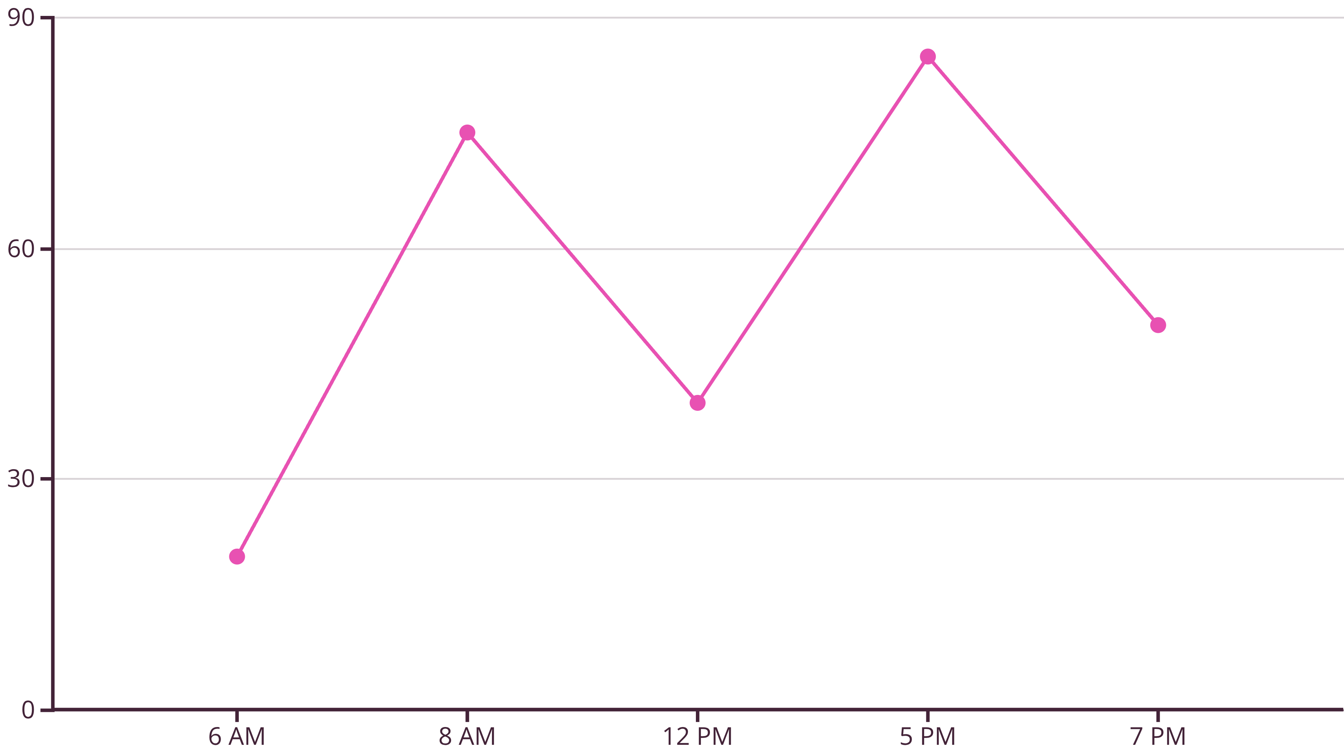
Preliminary Results & Insights
Our initial analysis reveals strong correlations between congestion levels and specific variables such as time of day, day of week, and major public events.
The model shows promising accuracy in predicting congestion peaks.

Slide 8
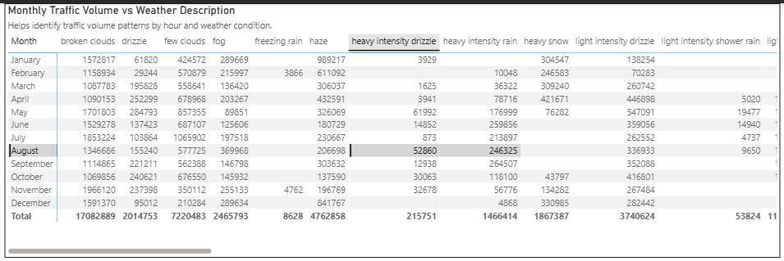
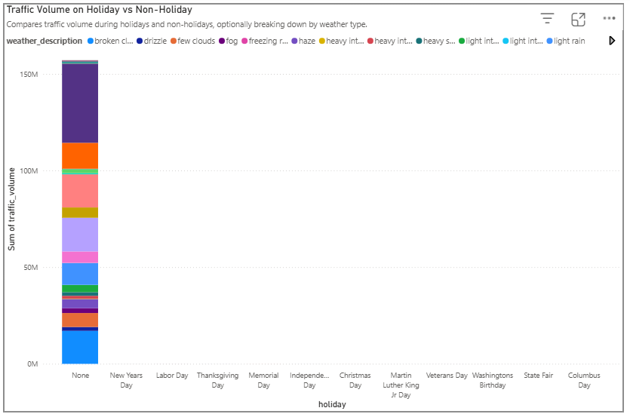
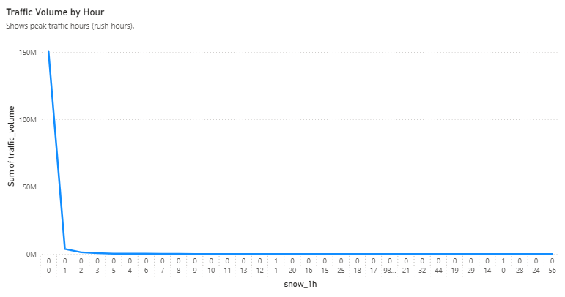
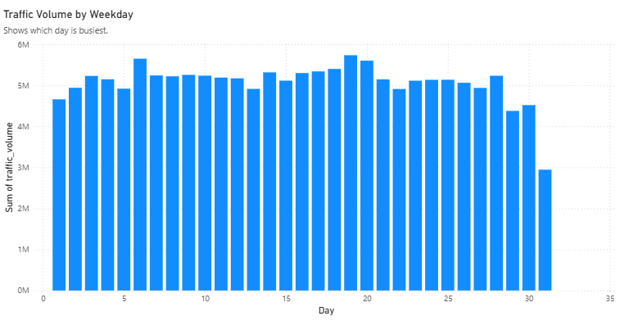
Power BI Summary: Visualizing Traffic Congestion.
Power BI used in creating interactive dashboards to visualize traffic patterns, congestion hotspots, and predictive model outputs. These dashboards allow for easy exploration of data by stakeholders.

Slide 9
Recommendations & Future Work
Recommendations:
Future Work:
Integrate real-time social media data for immediate event impact.
Explore deep learning models (e.g., LSTMs) for time-series prediction.
Develop adaptive traffic signal control systems based on predictions.
Expand scope to include multi-modal transportation analysis (cycling, walking).
Advise public transit agencies on optimal route adjustments during congestion.
Build a user-friendly mobile application for public access to predictions.

Slide 10

Conclusion:
Towards Smarter Cities
This capstone project demonstrates the immense potential of big data analytics in tackling complex urban challenges. By accurately predicting traffic congestion, we can contribute to creating more efficient, sustainable, and livable smart cities for everyone. The insights gained is the way for real-world applications in urban planning and emergency response.

